Slide 1
Project Presentation of Industry Oriented Hands on Experience (22CS422)
On
EdNote’s E-Learning Website
Abhishek, Abhay, Aditya Sharma, Ayushman Bansal
2210991158, 2210991140, 2210991200, 2210991431
Supervised By:-
Dr. Ajay Kumar
Department of Computer Science and Engineering,
Chitkara University, Punjab

Slide 2
Introduction
EdNote’s is an e-learning website experience with MCQ based practice with course, helping learners to practice and enhance their knowledge in a one well-organized platform.
This platform also provides smart notes, interactive flashcards learning making it easier to understand topics efficiently and revise anytime through these learning methods.
In addition, EdNote’s also integrates performance analytics feature to enhance the student learning experience and academic performance in an organized and accessible manner.
2

Slide 3
Problem Statement
With the rise of the digital education system, students are rapidly accessing and depending on online learning resources for their academic support and exam preparation. However, due to the availability of various educational websites, many platforms provide either study-related material or tests for practice and lack personalized practice tools but rarely all in a single well-organized platform. Students repeatedly switch between many applications for different learning materials, such as MCQ practice, notes, and interactive flashcards, leading to inefficient learning and confusion. Additionally, the lack of proper progress and structured courses affects consistency and learning. This scattered learning experience that highlights the need for an integrated learning platform.

Slide 4
Tools and Technologies
EdNote’s is built using MERN stack, ensures scalability, performance and modern architecture.
MongoDB:
A NoSQL database used to store user details and other data.
Enables dynamic schema support.
Express.js:
Web application framework for handling backend logic and APIs.
Secure data transfer between frontend and backend.
React:
A library for creating dynamic and user-friendly interfaces.
Ensures a seamless user experience.
Node.js:
A server-side JavaScript runtime environment, allowing fast and real-time interactions and scalable development.

Slide 5
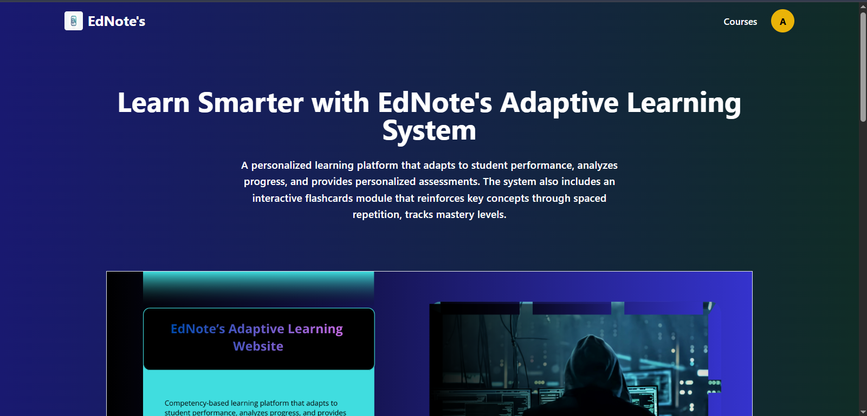
Project Snapshots

Slide 6
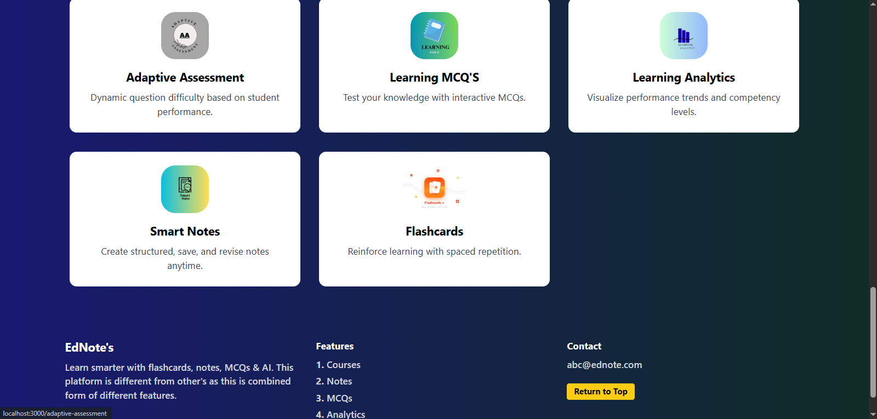

Slide 7
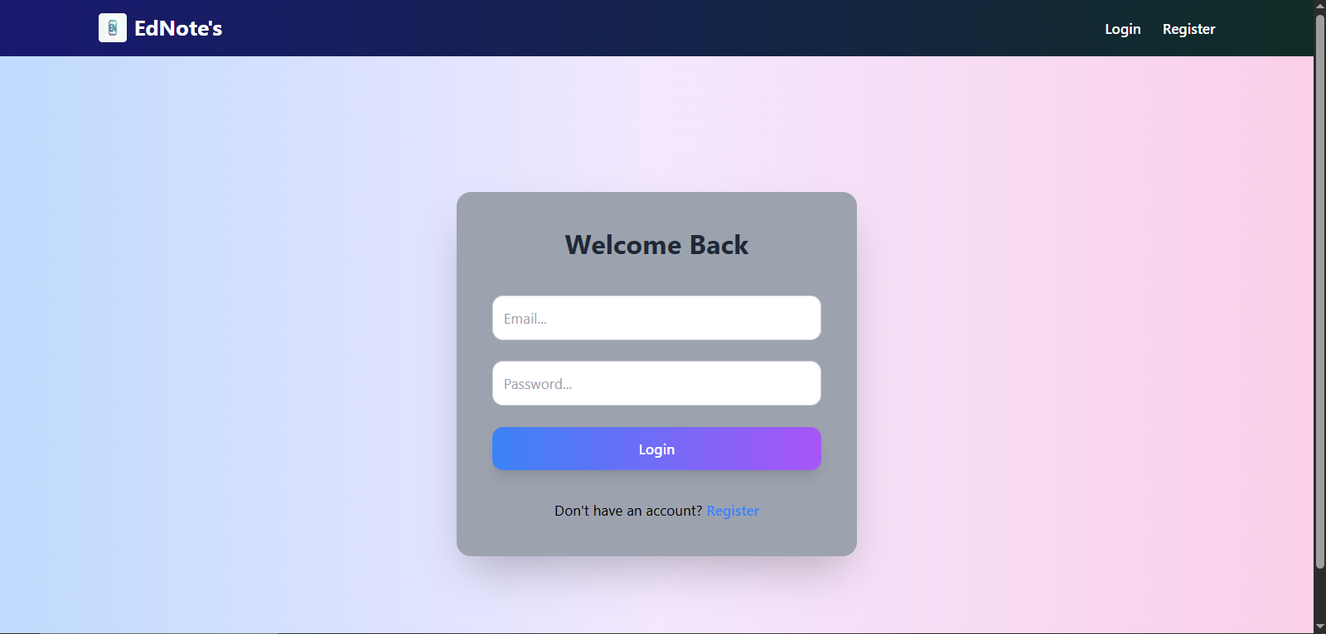

Slide 8
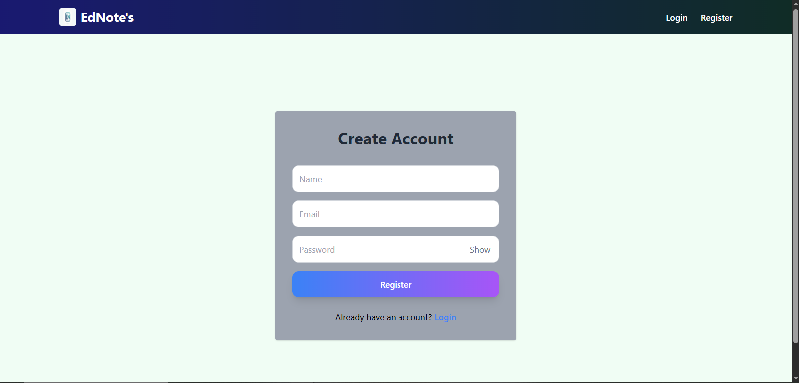

Slide 9
Software & Hardware Requirements
Software Requirements
Operating System: Windows 10/11 and macOS
Programming Language: JavaScript (React for Frontend, Node.js for Backend)
Database: MongoDB
Code Editor: Visual Studio Code
Package Manager: npm
Hardware Requirements
Processor: Intel Core i5 or better
Internet: Stable speed connection
RAM: 8GB or 16 GB
Storage: 100GB SSD

Slide 10
Key Features
MCQ’s and Courses: EdNote’s provide a comprehensive collection of MCQ feature and also including courses part, helping to practice topics and learning to enhance knowledge.
Smart Notes: This feature simplify the study process with adding notes of particular topic, to pin important ones, to search within notes and deleting notes to make revision faster and more effective.
Interactive Flashcards: Make revision easy by using flashcards to support in recalling topics that help in retain information longer in very effective way.
Analytics: This feature provides a visual representation of score trend and topic-wise performance through charts. Helping users to get a clear view to identify areas to do better and improve accordingly.

Slide 11
Future Scope
AI Integration: Use of AI will enhance learning and make it easier for user to ask for any question and receive instant support, which helps maintain their interest and focus on their goals.
Offline Study Mode: Users will be able to download courses, notes, and flashcards to study without any internet connection.
Certification: After completing every module or courses, certificates will be issued to boost your career prospects.
Mobile App: Making the platform accessible anytime.
Paid Courses: Users will be able to purchase courses through secure payment transactions.

Slide 12
Conclusion
EdNote’s E-Learning Website is a well-structured e-learning platform that enhances learning through MCQ based practice, courses. It also includes smart notes, interactive flashcards and analytics features to help learners.
Enhances learning efficiency and user engagement.
Improves accessibility by providing a centralized online learning website.
Supports comprehensive learning with combined features.
Enables consistent practice, leading to improved performance.

Slide 13
References
https://www.mongodb.com
https://expressjs.com
https://reactjs.org
https://nodejs.org

Slide 14
Thank You
14

